Slide 1
WELCOME

Slide 2

E-Commerce Website Stationery Store
By
Sudharshan Rakhonde

Slide 3
Introduction

Slide 4
What is E-Commerce
Commonly know as Electronic marketing
“It consist of buying and selling goods and services over an electronic systems such as the internet and other computer networks”

Slide 5
Our System
Our System is an e-commerce website from where people can buy products online.
User can see the Analytics of product demands and Product sold

Slide 6
Features:
Menu
Catalog Browsing
Category List
Product List
Product Browsing
Product Review
Related products
Shopping Cart
Catalog Management
Checkout
Generate Bill
Payment gateway
Confirmation

Slide 7
Languages:
Tools:
HTML5
CSS3
Bootstrap
React
Commerce API
Charts
Visual Studio code
Adobe Photoshop
Chrome Browser

Slide 8
Advantage of E-commerce
Faster buying/selling procedure, as well as easy to find products.
Buying/selling 24 X 7.
Low operational cost and better quality od services.
No need of physical company set-up.
Easy to start and manage a business.

Slide 9
Disadvantages of E-Commerce
Unable to examine products personally.
Not everyone is connected to the internet.
There is the possibility of credit card number.
Mechanical failures.

Slide 10
GUI (Graphical User Interface)

Slide 11
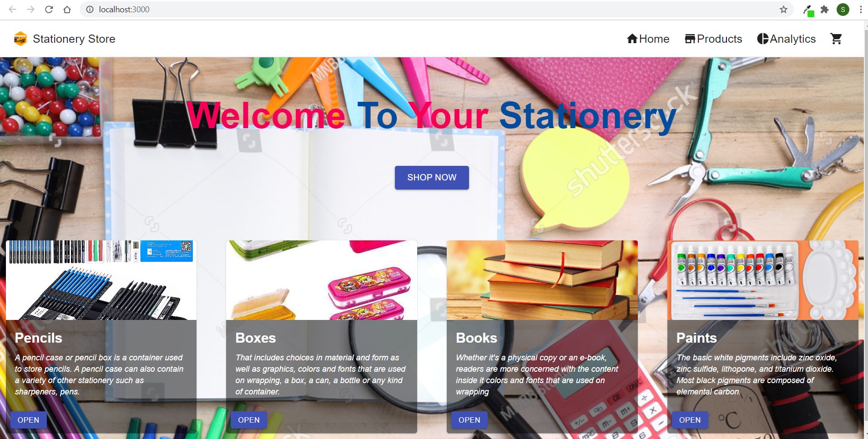
Home Page

Slide 12
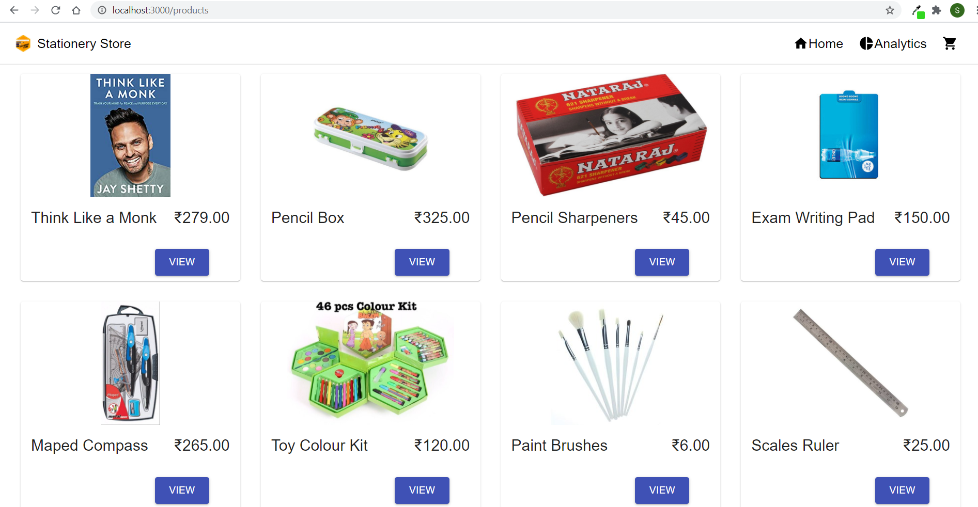
Product Page

Slide 13
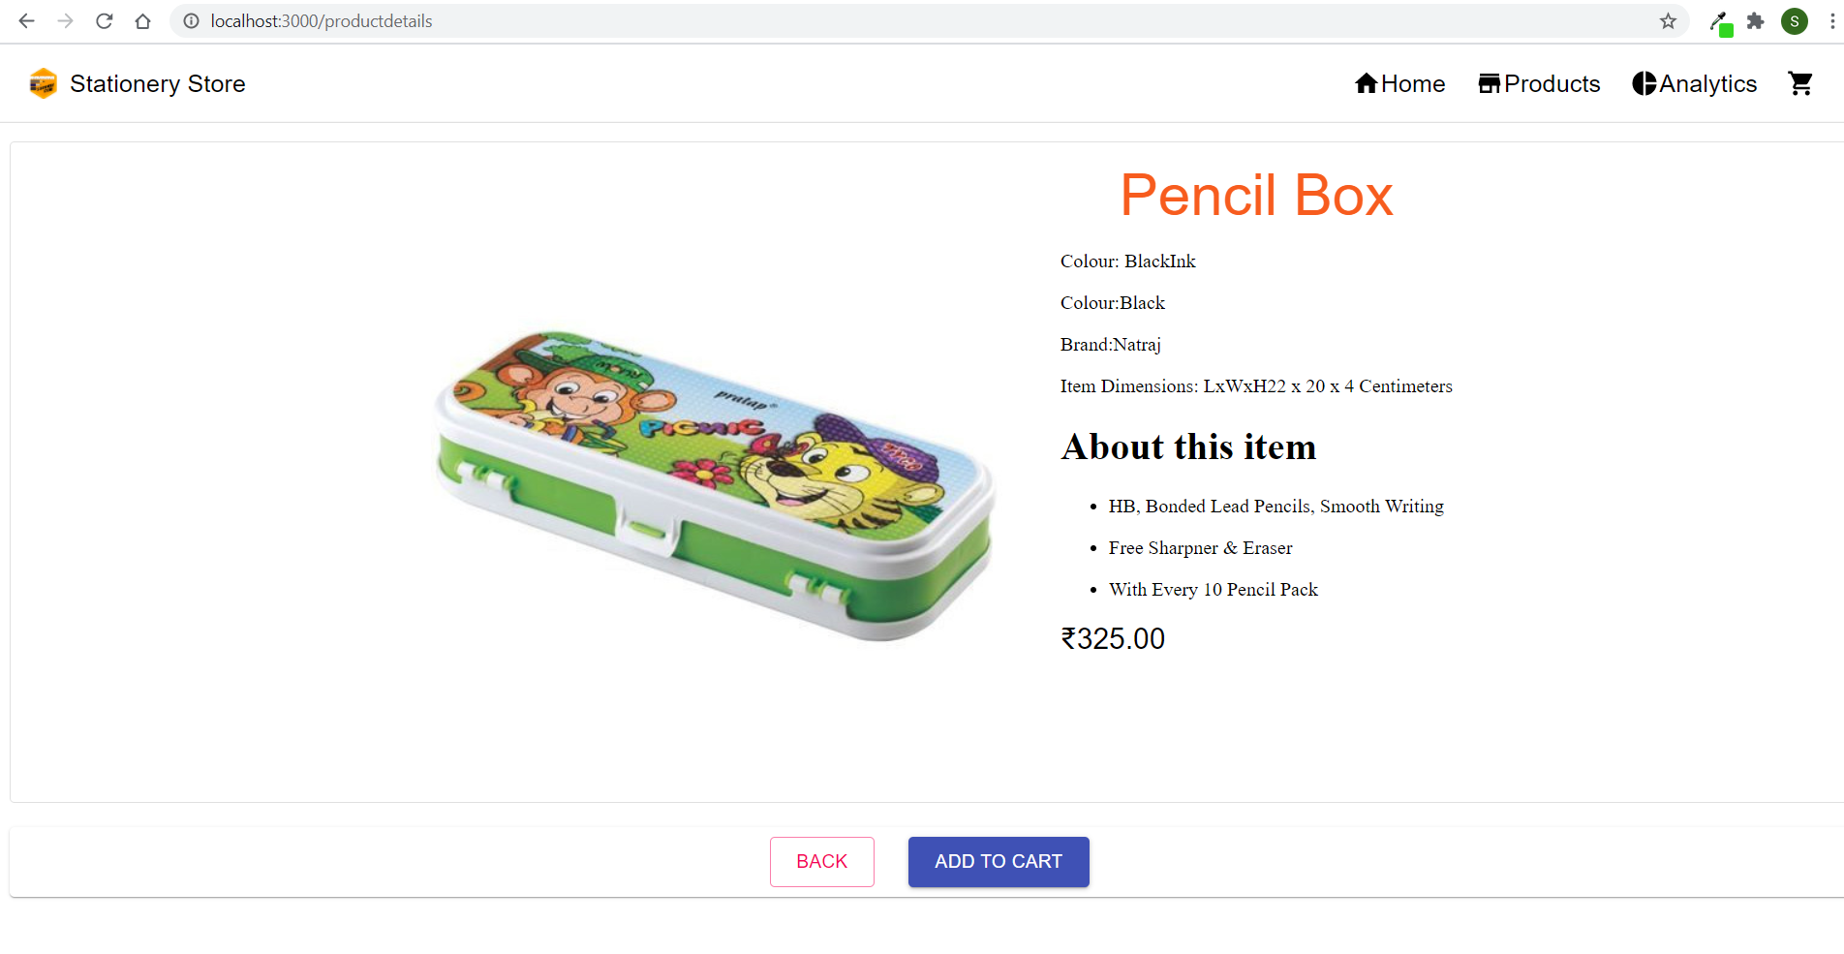
Product Details Page

Slide 14
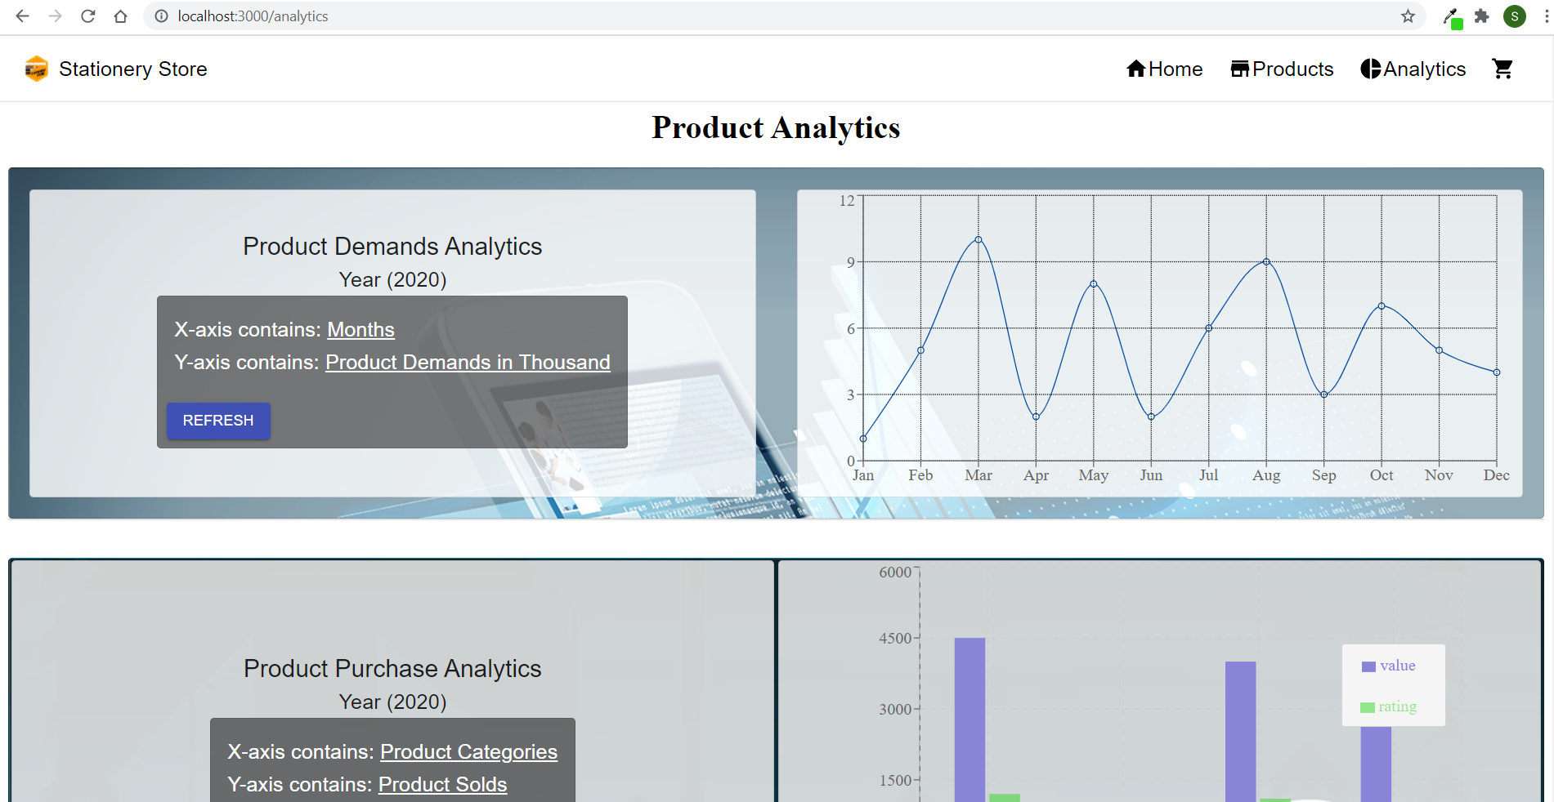
Analytics Page

Slide 15
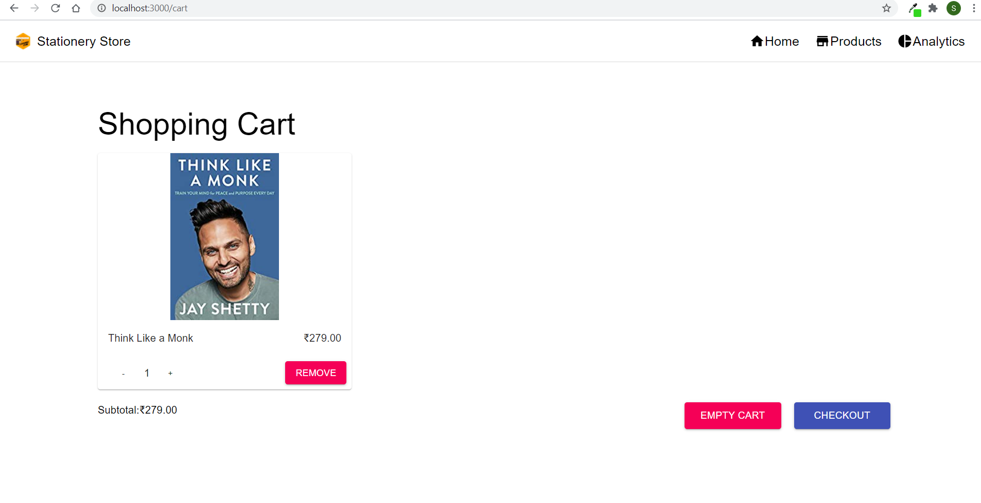
Shopping Cart Page

Slide 16
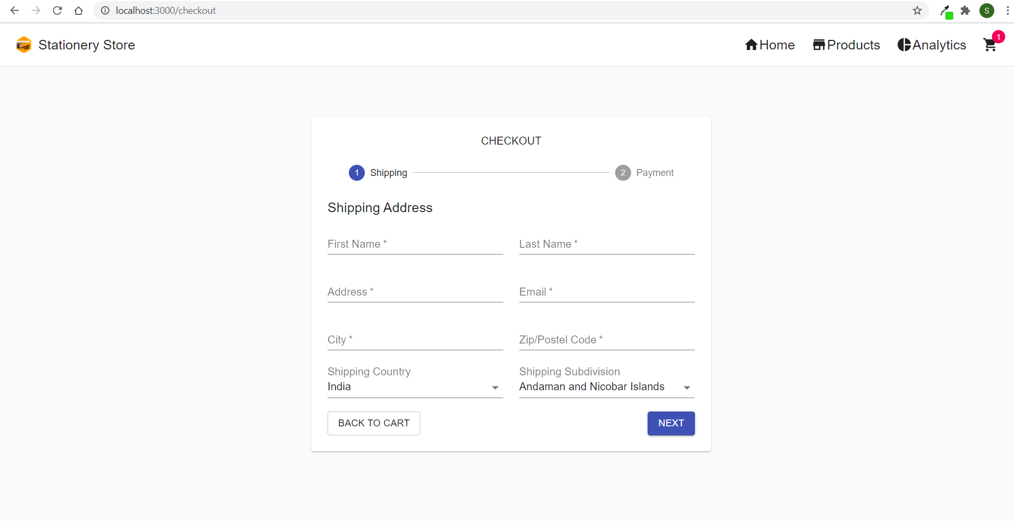
Shipping page

Slide 17
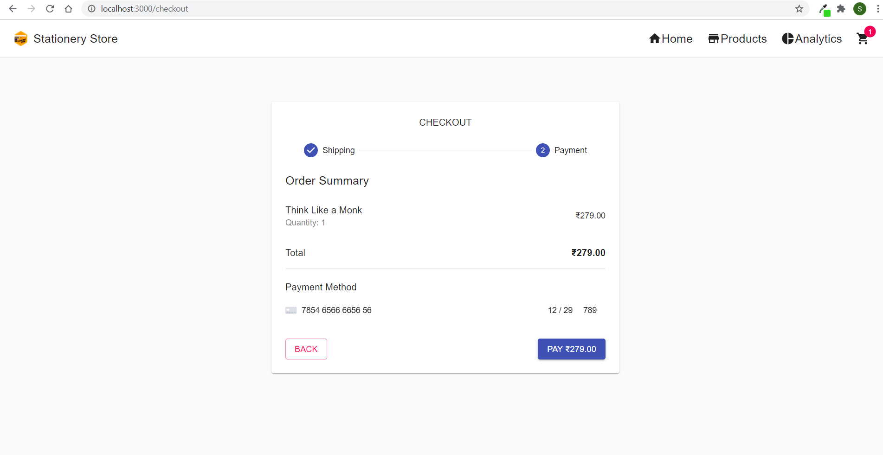
Payment Page

Slide 18
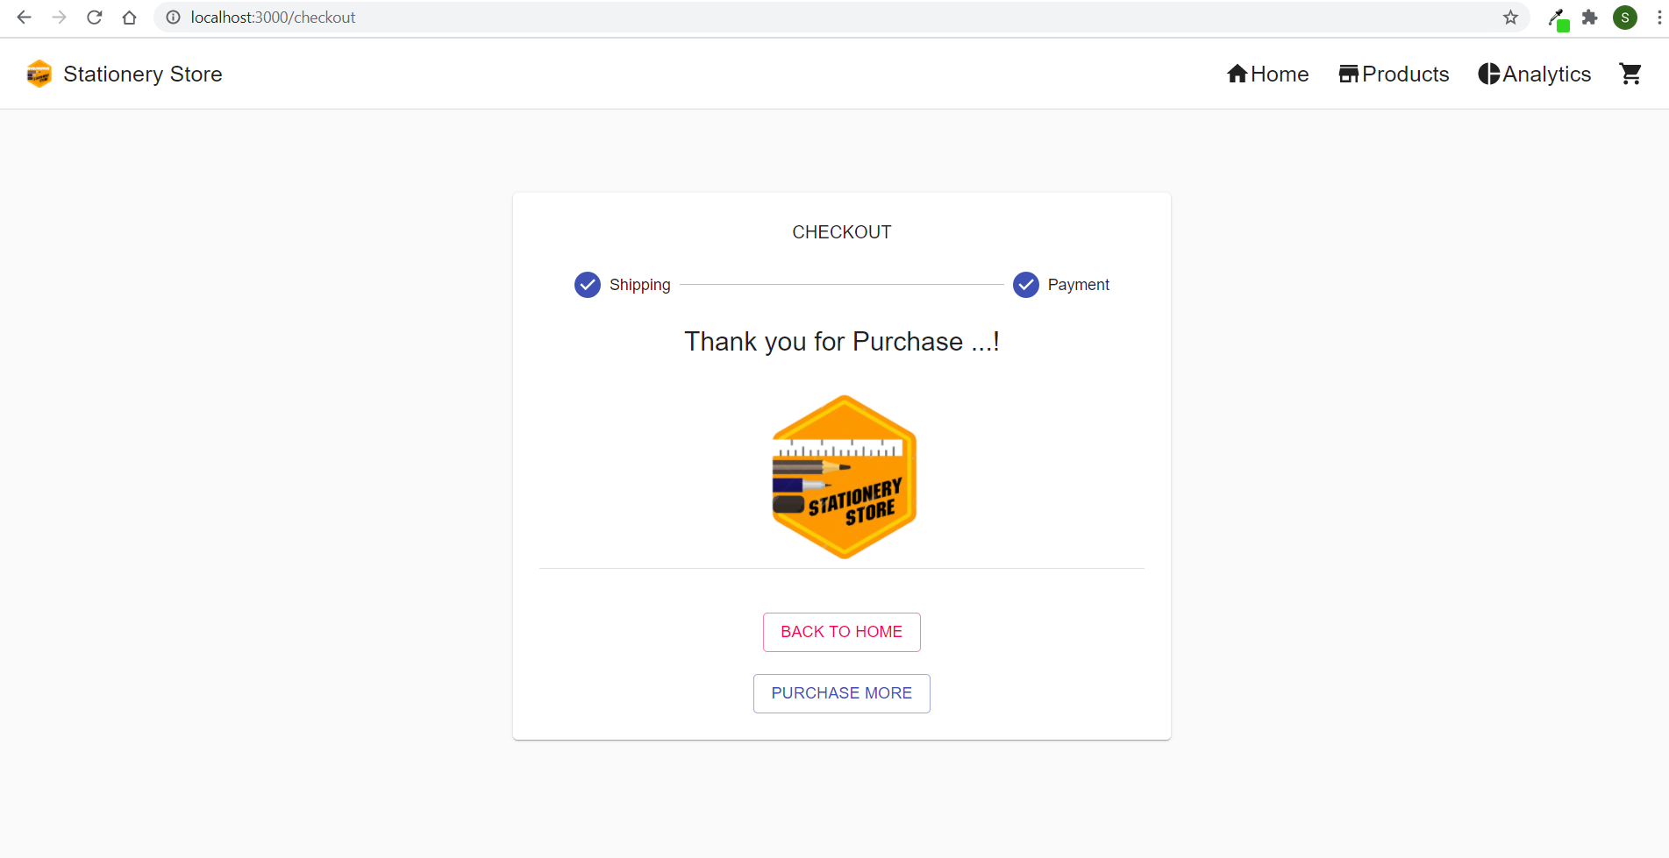
Confirmation Page

Slide 19
Thank You !

